Slide 1
Unit 1.1 Process Management
Chapter 2 of Text Book

Slide 2
Objectives
After studying this unit, you should be able to
Explain process state
Describe the process control block(PCB)
Discuss the process scheduling
Describe threads in Operating system

Slide 3
Process Concept
An operating system executes a variety of programs
batch systems - jobs
time-shared systems - user programs or tasks
job and program used interchangeably
Process - a program in execution
process execution proceeds in a sequential fashion
A process is an activity of some kind, it has program, input, output and state.

Slide 4
Process Model
Uni-programming
Multiprogramming
Multiprocessing

Slide 5
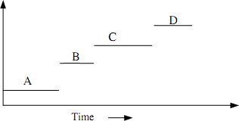
Uni-programming Model
Only one process at a time
Examples: Older systems
Advantages: Easier for OS designer
Disadvantages: Not convenient for user and poor
performance

Slide 6
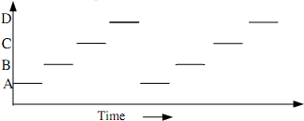
Multiprogramming Mode
multiple process at a time
OS requirements for multiprogramming:
Policy: to determine which process is to schedule.
Mechanism: to switch between the processes.
Examples: Unix, WindowsNT
Advantages: Better system performance and user convenience.
Disadvantages: Complexity in OS

Slide 7
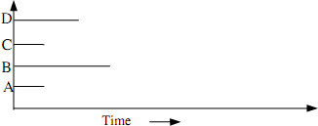
Multiprocessing Model
System with multiple processor
Distributed OS and Network OS

Slide 8
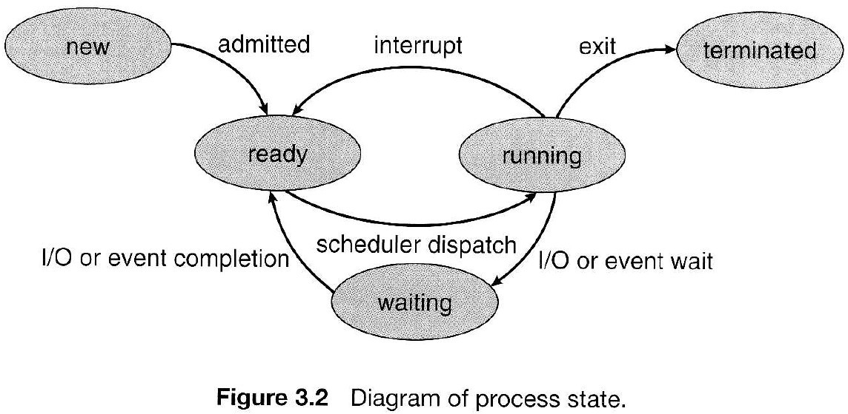
Process States diagram
Figure 3.2

Slide 9
Process States
New - The process is being created.
Running - Instructions are being executed.
Waiting - Waiting for some event to occur.
Ready - Waiting to be assigned to a processor.
Terminated - Process has finished execution.

Slide 10
Process Control Block
Process must be saved when the process is switched from one state to another so that it can be restarted later as it had never been stopped.
The PCB is the data structure containing certain important information about the process -also called process table or processor descriptor.
Process state: running, ready, blocked.
Program counter: Address of next instruction for the process.
Registers: Stack pointer, accumulator, PSW etc.
Scheduling information: Process priority, pointer to scheduling queue etc.
Memory-allocation: value of base and limit register, page table, segment table etc.
Accounting information: time limit, process numbers etc.
Status information: list of I/O devices, list of open files etc.

Slide 11
PCB
The PCB simply serves as repository of any information that may vary from process to process.
Process state
Process number
Program counter
Registers
Memory Limits
List of open files
…….

Slide 12
Operation on process
The processes in the system can execute concurrently, and they must be created and
deleted dynamically. OS
provide the
creation and
mechanism for process termination.
Process Creation.
Process Termination

Slide 13
Process Creation
There are four principal events that cause the process to be created:
» System initialization.
» Execution of a process creation system call.
» User request to create a new process.
» Initiation of a batch job.
A process may create several new processes during the course of execution. The creating process is called a parent process, where as the new processes are called children of that process.

Slide 14
Process Termination
Process are terminated on the following conditions
Normal exit.
Error exit.
Fatal error.
Killed by another process.
Example:
In Unix the normal exit is done by calling a exit system call. The process returns data (output) to its parent process via the wait system call.
kill system call is used to kill other process.

Slide 15
Process Scheduling
Main objective of multiprogramming is to maximize the CPU utilization.
At any time, a process is in any one of the new, ready, running or waiting state.
The OS module known as scheduler, schedules processes from ready queue for execution by CPU
Scheduler select one of the many process from ready queue on certain criteria.
(Will discuss it in detail in next chapter)

Slide 16
Context Switch
CPU switching form one process to another requires saving the state of the current process and loading the latest state of next process.
This is known as context switch.
The time require to context switch is a overhead since it does not produce any useful work in aspect of process execution time.

Slide 17
Thread
It is a single sequence stream which allows a program to split itself into two or more simultaneously running task.
It is the basic unit of CPU utilization and consists of program counter, a register set and a stack space.
Sometime called light weight process.

Slide 18
Thread and Process
Threads are not independent as process.
Thread shares with other thread: code section, data section, Other resource such as opens files.
Similarities:
Like process, thread share CPU and only one thread is running at a time.
Like process, thread within processes execute sequentially
Like process if one thread is blocked, another can run.

Slide 19
Thread and process
Dissimilarities
Unlike process, threads are not independent of each other.
Unlike process, all threads can access every address space.
Unlike process, threads are designed to assist one other.

Slide 20
IPC(Inter Process Communication)
How one process can pass the information to the another?
How to make sure two or more processes do not get into each other’s way when engaging in critical activities?
How to maintain the proper sequence when dependencies are presents?
Thus, Inter Process Communication (IPC) and synchronization are needed.
IPC provide the mechanism to allow the processes to communicate and to synchronize their actions.

Slide 21
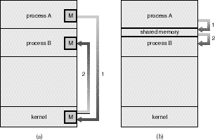
IPC models
There are two fundamental models of inter- process communication:
Shared Memory:
Message Passing.

Slide 22
Massage Passing
Communication takes place by means of messages exchanged between the cooperating processes.
Message passing is useful for exchanging smaller amounts of data, because no conflicts need be avoided. Message passing is also easier to implement than shared memory for inter-computer communication.

Slide 23
Shared Memory
A region of memory that is shared by cooperating processes is established.
Processes can then exchange information by reading and writing data to the shared region.
Shared memory allows maximum speed and convenience of communication, as it can be done at memory speeds when within a computer.
Shared memory is faster than message passing, as message-passing systems are typically implemented using system calls and thus require the more time- consuming task of kernel intervention.

Slide 24
Massage passing Vs Sharing Memory
In contrast, in shared-memory systems, system calls are required only to establish shared-memory regions. Once shared memory is established, all accesses are treated as routine memory accesses, and no assistance from the kernel is required.

Slide 25
Process Synchronization
Synchronization is often necessary when processes communicate.
Processes are executed with unpredictable speeds. One can view synchronization as a set of constraints on the ordering of events.
The programmer employs a synchronization mechanism to delay execution of a process in order to satisfy such constraints.
As an illustrative example, consider the batch operating system again. A shared buffer is used for communication between the reader process and the writer process.
These processes must be synchronized so that, for example, the reader process never attempts to read data from the input if the buffer is empty.

Slide 26
Race Condition
Situation where two or more processes are reading or writing some shared data and the final result depends on who run precisely, are called race conditions

Slide 27
Race Condition?
Possibilities of race:
one process reading and another process writing same data.
two or more process writing same data.
Solution: prohibiting more than one process from reading /writing the same data at the same time- Mutual Exclusion.

Slide 28
Solution to Race condition
Make an operating system not to perform several tasks in parallel. This is called serialization. Two strategies to serializing processes in a multitasking environment:
The Scheduler can be disabled
A Protocol can be introduced
Scheduler can be disabled for a short period of time, to prevent control being given to another process during a critical action like modifying shared data. This will be inefficient on multiprocessor machines, since all other processors have to be halted every time one wishes to execute a critical section.
A protocol can be introduced which all programs sharing data must obey. The protocol ensures that processes have to queue up to gain access to shared data.

Slide 29
Then what is Mutual Exclusion really?
Some way of making sure that if one process is using a shared variables or files, the other process will be excluded from doing the same thing.

Slide 30
Critical-Section Problem
Code executed by the process can be grouped into sections, some of which require access to shared resources, and other that do not.
The section of the code that require access to shared resources are called critical section.
Facts: The part of the time, process is busy doing internal computations and other things that do not lead to the race condition. Non critical section
Helpful to avoid race condition.

Slide 31
Critical-Section Problem
General structure of process Pi (other process Pj)
do{
entry_section
critical_section(CR)
exit_section
reminder_section
} while(true)
When a process is accessing a shared modifiable data, the process is
said to be in critical section.
All other processes (those access the same data) are excluded from their own critical region.
All other processes may continue executing outside their CR.
When a process leaves its critical section, then another processes
waiting to enter its own CR should be allowed to proceed.

Slide 32
Critical-Section Problem
The critical section problem is to design a
protocol that the processes can use to co-operate.
A good solution to critical section problem must satisfy the following three requirements.
No two processes may be simultaneously inside their CRs (mutual exclusion).
No process running outside its CR may block other process.(Progress)
No process should have to wait forever to enter its CR.(Bounded Waiting)

Slide 33
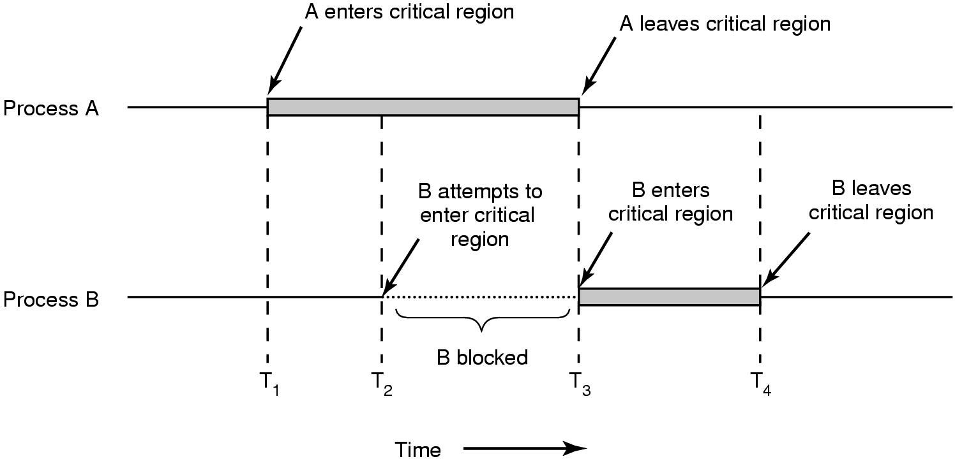
Critical Section diagram (with mutual exclusion)

Slide 34
Solution 1(Busy waiting) Interrupt Disabling
Each process disable all interrupts just after entering its CR
and re-enable them just before leaving it.
No clock interrupt, no other interrupt, no CPU switching to other process until the process turn on (enable) the interrupt.
The general structure of process may be as
Do
{
DisableInterrupt()
// perform CR task EnableInterrupt()
//perform Remiander section task
}while(1);

Slide 35
Facts about Disabling Interrupts
Advantages:
Mutual exclusion can be achieved by implementing OS primitives to disable and enable interrupt.
Problems:
allow the power of interrupt handling to the user.
The chances of never turned on is a disaster.
it only works in single processor environment.

Slide 36
Solution 2(Busy waiting) Lock Variables
A single, shared (lock) variable, initially 0.
When a process wants to enter its CR, it first test the lock. If the lock is 0, the process set it to 1 and enters the CR. If the lock is already 1, the process just waits until it becomes 0.
The general structure of process is
Do{
While(lock!=0); //busy waiting
Lock=1;
//perform the CR task Lock=0
//perform Non CR task
}while(true)

Slide 37
Facts
Advantages: seems no problems.
Problems:
problem like spooler directory;
suppose that one process reads the lock and sees that it is 0, before it can set lock to 1, another process scheduled, enter the CR, set lock to 1 and can have two process at CR (violates mutual exclusion)

Slide 38
Strict Alternation
Processes share a common integer variable
turn.
If turn == i
Then process Pi is allowed to execute in its CR,
if turn == j
then process Pj is allowed to execute.

Slide 39
Strict Alternation
While (true){ while(turn!=i); /*loop*/
critical_section(); turn = j;
noncritical_section
}
While (true){ while(turn!=j); /*loop*/
critical_section(); turn = i;
noncritical_section
}
Structure of Process Pi
Structure of Process Pj

Slide 40
Facts
Ensures that only one process at a time can be in its CR.
Problems: strict alternation of processes in the execution of the CR.
– What happens if process i just finished CR and again need to enter CR and the process j is still busy at non-CR work? (violate condition 2)

Slide 41
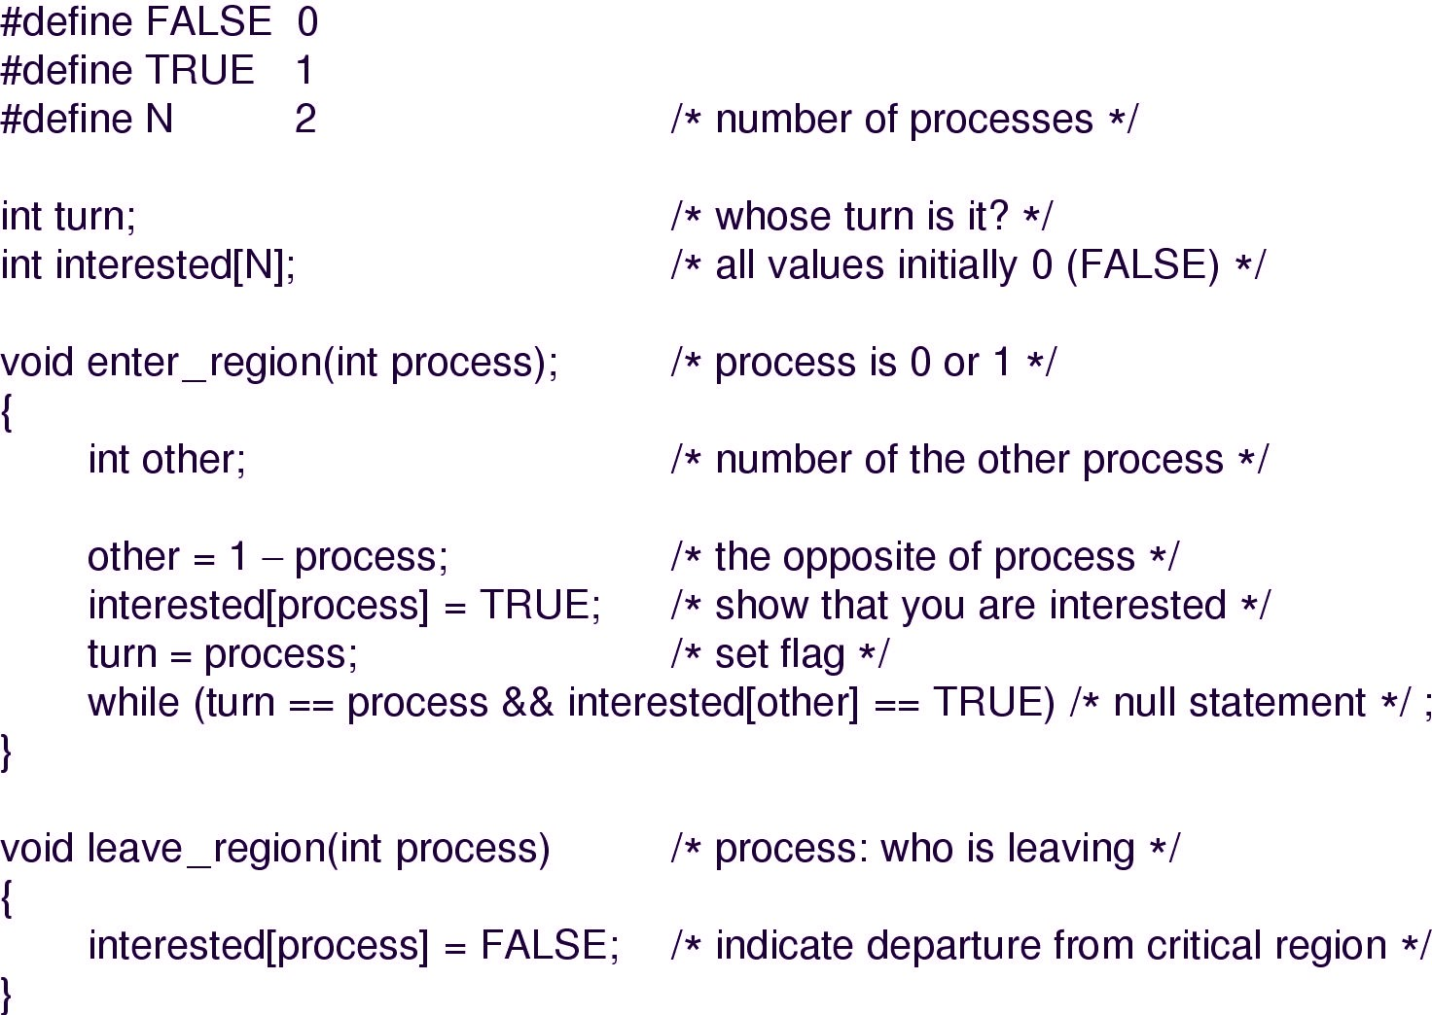
Peterson’s solution

Slide 42
Facts about Petersons
Before entering its CR, each process call enter_region with its own process number, 0 or 1 as parameter.
Call will cause to wait, if need be, until it is safe to enter.
When leaving CR, the process calls leave_region to indicate that it is done and to allow other process to enter CR.
Advantages: Preserves all conditions.
Problems: difficult to program for n-processes system and less efficient.

Slide 43
Hardware Assistance(TSL)
Checking for mutual exclusion is also possible through Hardware.
Specific instruction called Test and Set Lock(TSL) is used for this purpose.
The special properties of these instruction is that they cant be interrupted i.e. they are atomic instruction and carried out with out interruption.

Slide 44
TSL instruction
Test and Set Lock (TSL) instruction reads the contents of the memory word lock (shared variable) into the register and then stores nonzero value at the memory address lock.
This automatically as in a un-interruptible time unit.
The CPU executing TSL locks the memory bus to prohibit other CPUs from accessing memory until it is done.
When lock is 0, any process may set it to 1 using the TSL instruction.
When it is done the process lock back to 0.

Slide 45
Alternate to Busy waiting
Busy waiting:
When a process want to enter its CR, it checks to see if the entry is allowed, if it is not, the process
just sits in a tight loop waiting until it is.
Waste of CPU time for NOTHING!
Possibility of Sleep and Wakeup pair instead of waiting.
Sleep causes to caller to block, until another process wakes it up.

Slide 46
Sleep and week up Consumer Producer problem
Two process share a common, fixed sized buffer.
Suppose one process, producer, is generating information that the second process, consumer, is using.
– Their speed may be mismatched, if producer insert item rapidly the buffer will full and go to the sleep until consumer consumes some item, while consumer consumes rapidly, the buffer will empty and go to sleep until producer put something in the buffer.

Slide 47
Conti.
#define N = 100 /* number of slots in the buffer*/ int count = 0; /* number of item in the buffer*/
void producer(void)
{
int item; while(TRUE)
{ /* repeat forever*/
item = produce_item(); /*generate next item*/
if (count == N)
sleep(); /*if buffer is full go to sleep*/ insert_item(item); /* put item in buffer */ count = count +1; /*increment count */
if (count == 1) wakeup(consumer);
/* was buffer empty*/
}

Slide 48
Cont……
void consumer(void)
{
int item; while(TRUE)
{ /* repeat forever*/
if(count == 0)
sleep(); /* if buffer is empty go to sleep*/
item = remove_item(); /*take item out of buffer*/ count = count -1; /*decrement count*/
if (count == N-1)
wakeup(producer); /*was buffer full ?*/ consume_item(); /*print item*/
}
}

Slide 49
Producer Consumer with weak up and sleep signals
Problem:
leads to race as in Lock variable.
What happen if
When the buffer is empty, the consumer just reads count and quantum is expired, the producer inserts an item in the buffer, increments count and wake up consumer.
The consumer not yet asleep, so the wakeup signal is lost, the consumer has the count value 0 from the last read so go to the sleep.
Producer keeps on producing and fill the buffer and go to sleep,
both will sleep forever.
Think: If we were able to save the wakeup signal that was lost........(semaphores)

Slide 50
Semaphores
E. W. Dijkstra (1965) suggested using an integer variable to count
the number of wakeups, called a semaphore.
It could have the value 0, indicating no wakeups were saved, or some positive value if one or more wakeups were pending.
Operations: Down and Up (originally he proposed P and V in Dutch and sometimes known as wait and signal)
Down: checks if the value greater than 0
yes- decrement the value (i.e. Uses one stored wakeup) and continues.
No- process is put to sleep without completing down.
Checking value, changing it, and possibly going to sleep, is all done as single action.
Up: increments the value; if one or more processes were sleeping, unable to complete earlier down operation, one of them is chosen and is allowed to complete its down.

Slide 51
Semaphore Operations
void down(S)
{
if(S> 0)
S--;
else
sleep(); //wait until s>0
}
void up (S)
{
if(one or more processes are sleeping on S) one of these process is proceed;
else
S++;
}

Slide 52
Semaphore: Discussions
To avoid busy waiting, a semaphore may have an associated waiting queue of process.
If process does a down operation on a semaphore which is zero, the process is added to the semaphore’s queue.
When another process increments the semaphore by doing up operation and there are task in the queue, one is taken off and resumed.

Slide 53
Consumer producer using Semaphore
#define N 100 /*number of slots in buffer*/ typedef int semaphore; /*defining semaphore*/
semaphore mutex = 1; /* control access to the CR */ semaphore empty = N /*counts empty buffer slots*/ semaphore full = 0; /counts full buffer slots*/
void producer(void)
{
int item;
while(TRUE){ /*repeat forever */
item = produce_item(); /*generate something */ down(empty); /*decrement empty count*/ down(mutex); /*enter CR */
insert_item(); /* put new item in buffer*/ up(mutex); /* leave CR*/
up(full); /*increment co_{B}u_{y A}n_{s}t_{st.}o_{P}f_{ro}f_{f}u_{. T}l_{e}l_{j} s_{B}l_{a}o_{ha}t_{d}s_{u}*_{r}/_{S}
}
53

Slide 54
Consumer producer using Semaphore
void consumer(void)
{
int item;
while(TRUE){ /*repeat forever*/ down(full); /*decrement full count */ down(mutex); /*enter CR*/
item = remove_item(); /*take item from buffer*/
up(mutex); /*leave CR*/
up(empty); /*increment count of empty slots*/ consume_item(); /*print item*/
}
}

Slide 55
Semaphore’s attraction
They have the following attractive properties
Machine independent
Simple
Powerful: provide exclusion and waiting
Work with many process
Can ask for many resources simultaneously with multiple down operations

Slide 56
Message Passing
With the trend of distributed operating system, many OS are used to
communicate through Internet, intranet, remote data processing etc.
Inter process communication based on two primitives operations:
send
and receive.
The general syntax for these operations looks like
send(destination, &message);
receive(source, &message);
The send and receive calls are normally implemented as operating system calls accessible from many programming language environments.

Slide 57
Producer-Consumer with Message Passing
#define N 100 /*number of slots in the buffer*/
void producer(void)
{ int item;
message m; /*message buffer*/ while (TRUE){
item = produce_item(); /*generate something */ receive(consumer, &m); /*wait for an empty to arrive*/ build_message(&m, item); /*construct a message to send*/ send(consumer, &m); }
}
void consumer(void)
{ int item; message m;
for(i = 0; i<N; i++) send(producer, &m); /*send N empties*/
while(TRUE){
receive(producer, &m); /* get message containing item*/ item = extract_item(&m); /* extract item from message*/ send(producer, &m); /* send back empty reply*/ consume_item(item); /*do some^{B}t^{y}h^{A}in^{ss}g^{t.} w^{Pro}it^{f.}h^{Te}i^{j}te^{B}m^{aha}*^{d}/^{ur Shahi}
}
57

Slide 58
Message passing
No shared memory.
Messages sent but not yet received are buffered automatically by OS, it can save N messages.
The total number of messages in the system remains constant, so
they can be stored in given amount of memory known in advance.
Implementing Message Passing can be with:
Direct addressing: provide ID of destination.
Indirect addressing: Send to a mailbox.
Mail box: It is a message queue that can share by multiple senders and receivers, senders sends the message to the mailbox while the receiver pick ups the message from the mailbox.

Slide 59
Monitors
Higher level synchronization primitive.
A monitor is a programming language construct that guarantees appropriate access to the CR.
It is a collection of procedures, variables , and data structures that are all grouped together in a special kinds of module or package.
Processes that wish to access the shared data, do through the execution of monitor functions.
Only one process can be active in a monitor at any instant.

Slide 60
Monitors: discussion
A procedure defined within a monitor can access only those variables declared locally with in the monitors.
A monitor is an object or module intended to be used safely by more than one process.
The defining characteristic of a monitor is that its methods are executed with mutual exclusion.
That is, at each point in time, at most one process may be executing any of its methods.
This mutual exclusion greatly simplifies reasoning about the implementation of monitors compared to reasoning about parallel code that updates a data structure.

Slide 61
The Syntax of Monitors
Monitor monitor_name
{
shared variable declarations; procedure p1(){ ..... }
procedure p2(){ .... }
.... .
procedure pn(){ ...}
{initialization code;}
}

Slide 62
Homework 3
Discuss intercrosses communication in details
What is critical section and critical section problem?
What are semaphores? Explain.
What are monitors? Explains
Show the Peterson's algorithm preserve mutual exclusion, indefinite postponement and progress (deadlock)

